Slide 1
Module 4 Attacks and Defenses
Section 6 – System Misconfiguration
June 2018

Slide 2
OS security configuration best practices
The purpose of this section is to list all methods we can use to harden the OS
We have already seen of to secure OS boot process
We will see more on Windows other mechanisms:
Device Guard
Credential Guard
Security Baseline (SCT)
Auditing

Slide 3
.
Section 6 – System Misconfiguration
Learning Objectives
Explain attacks based on a misconfiguration of the system
Threats Overview
Countermeasures : Security Baseline (SCT), Just Enough Admin (JEA), Auditing, Credential Guard, Desired State Configuration (DSC), Network configuration, PowerShell Security

Slide 4
OS security configuration threats
Application and system updates (Windows Update/WSUS)
Adobe Flash vulnerability for IE integrated plug-ins
Schedule tasks running scripts in folder or share with incorrect permissions
Windows Firewall disabled(if no AV suite equivalent enabled)
To many accounts in Administrators group
PowerShell restriction policies unrestricted
Audit not set
Weak protocols (NTLMv1, SMBv1, etc).

Slide 5
OS security configuration threats – System not up to date
Application and system updates (Windows Update/WSUS)
Adobe Flash vulnerability for IE integrated plug-ins
SMBv1 vulnerabilities
Windows PDF Remote Code Execution Vulnerability
In the past with Petya/Wannacry: MS17-010 block ransomware propagation (ETERNALBLUE vulnerability). All system not protected were at risk
Several years ago same with Win32/Sasser worm was patched with MS04-011: all non patched machine were at risk.

Slide 6
OS security configuration threats – Scheduled Tasks
Risk if Scheduled Tasks relies on script either on local path or on a share, with unsufficient permissions on this folder/share.
An attacker may have sufficient privileges to modify the script and add malicious code that will be executed with highest privileges in the Task Scheculer context.

Slide 7
OS security configuration threats – Windows Firewall disable
Windows Firewall is enabled by default.
Caution: using some endpoint protection anti-virus solution might replace the Windows Firewall. Consequently the Windows Firewall in this situation is disabled.
With Win32/Sasser worm on machine not patched with MS04-011: enable the Windows Firewall helped stop propagation.

Slide 8
OS security configuration threats – Administrators members
Too many accounts in Administrators local group
Implies current user has most of the time too much privileges.
Running malicious code in privileged user context grant appropriate permission to attacker.
These high privileges were used by Petya/Wannacry attacks

Slide 9
OS security configuration threats – PowerShell unrestricted
PowerShell is powerful scripting shell.
By default, the Set-ExecutionPolicy is to default.
But for commodities the Set-ExecutionPolicy often changed to Unrestricted: any script content can be executed.

Slide 10
OS security configuration threats – PowerShell unrestricted
PowerShell is powerful scripting shell.
By default, the Set-ExecutionPolicy is to default. But for commodities the Set-ExecutionPolicy changed to Unrestricted: any script content can be executed.
PowerShell script may contain (except if best practice are implemented):
Script Encryption / Obfuscation
Code Injection
Hard-Coded Secrets

Slide 11
OS security configuration threats – Audit not set
Sometime Audit is the only method to detect security changes
By default Audit is not fully enabled and it’s quite confusing to identify what are the audit relevant entries.
One of the priority of the attacker is to remove his fingerprints, like clearing the security event log.
Another example: for brute force attack, monitor logon event to detect logon failures.

Slide 12
OS security configuration threats – Audit not set
Setting | Default | Baseline
Audit Policy: Account Logon: Credential Validation | No auditing | Success and Failure
Audit Policy: Account Management: Computer Account Management | No auditing | Success and Failure
Audit Policy: Account Management: Distribution Group Management | No auditing | Not Defined
Audit Policy: Account Management: Other Account Management Events | No auditing | Success and Failure
Audit Policy: Account Management: Security Group Management | Success | Success and Failure
Audit Policy: Account Management: User Account Management | Success | Success and Failure
Audit Policy: Detailed Tracking: Process Creation | No auditing | Success
Audit Policy: DS Access: Directory Service Access | No auditing | Success and Failure
Audit Policy: DS Access: Directory Service Changes | No auditing | Success and Failure

Slide 13
OS security configuration threats – Audit not set
Setting | Default | Baseline
Audit Policy: Logon-Logoff: Logoff | Success | Success
Audit Policy: Logon-Logoff: Logon | Success | Success and Failure
Audit Policy: Logon-Logoff: Special Logon | Success | Success
Audit Policy: Policy Change: Audit Policy Change | Success | Success and Failure
Audit Policy: Policy Change: Authentication Policy Change | Success | Success
Audit Policy: Privilege Use: Sensitive Privilege Use | No auditing | Success and Failure
Audit Policy: System: IPsec Driver | No auditing | Success and Failure
Audit Policy: System: Other System Events | Success and Failure | Success and Failure
Audit Policy: System: Security State Change | Success | Success and Failure
Audit Policy: System: Security System Extension | No auditing | Success and Failure
Audit Policy: System: System Integrity | Success and Failure | Success and Failure

Slide 14
OS security configuration threats – Audit not set
Sometime Audit is the only method to detect security changes
By default Audit is not fully enabled and it’s quite confusing to identify what are the audit relevant entries.

Slide 15
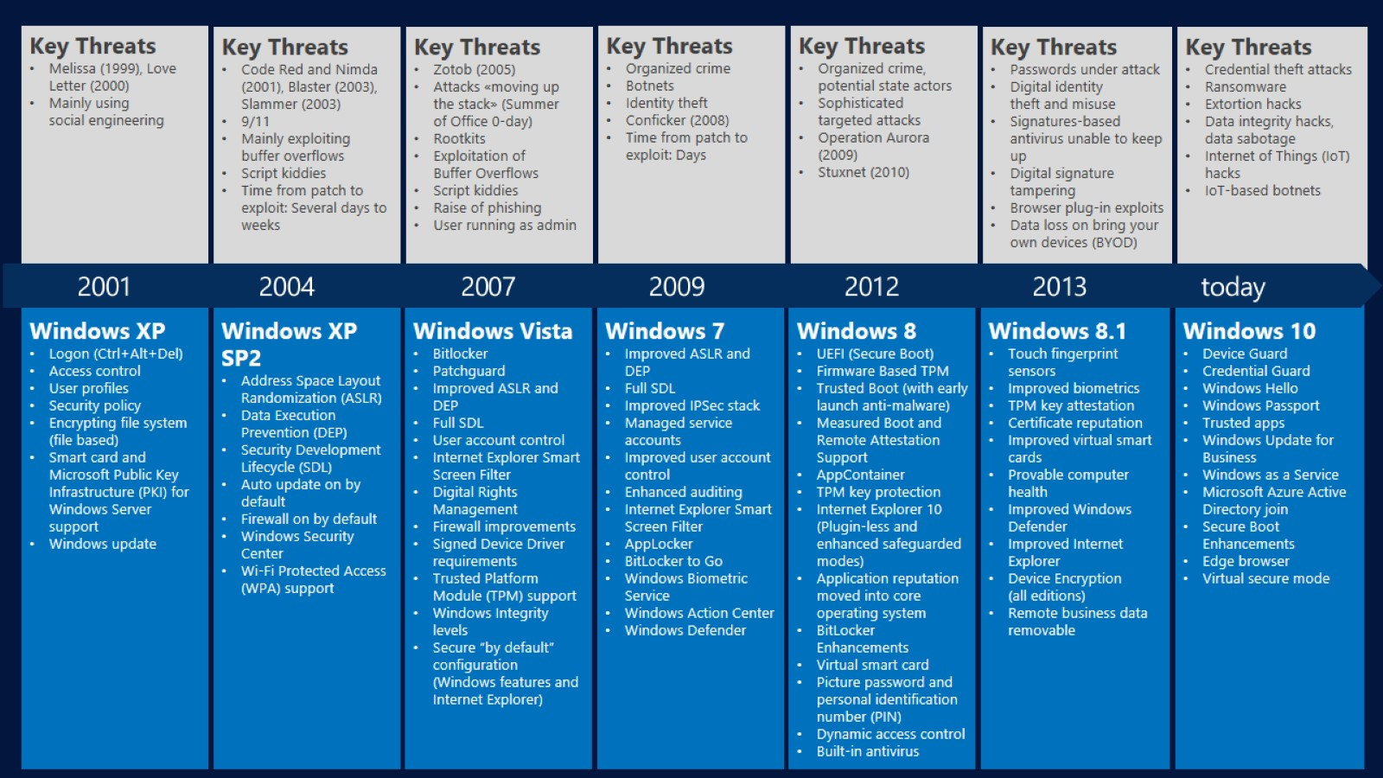
System and Threat evolution

Slide 16
Key concepts: Security Baseline (SCT)

Slide 17
Security Baseline
A security baseline is a group of Microsoft-recommended configuration settings that explains their security impact.
These settings are based on feedback from Microsoft security engineering teams, product groups, partners, and customers.
Download the security baselines from the Microsoft Download Center
Security baselines are included in the Security Compliance Toolkit (SCT),

Slide 18
Security Baseline
Security Baseline will help to harden system and check best practice depending on machine role:
See if Windows Firewall enable
List service not used/relevant
Review either local and group policies
Provide template to enable/disable security features
Select, adapt and deploy these parameters to avoid misconfiguration implementation

Slide 19
Audit – Highly and Medium criticality – Event to monitor
Current Windows Event ID | Legacy Windows Event ID | Potential Criticality | Event Summary
4618 | N/A | High | A monitored security event pattern has occurred.
4649 | N/A | High | A replay attack was detected. May be a harmless false positive due to misconfiguration error.
4719 | 612 | High | System audit policy was changed.
4765 | N/A | High | SID History was added to an account.
4766 | N/A | High | An attempt to add SID History to an account failed.
4794 | N/A | High | An attempt was made to set the Directory Services Restore Mode.
4897 | 801 | High | Role separation enabled:
4964 | N/A | High | Special groups have been assigned to a new logon.
5124 | N/A | High | A security setting was updated on the OCSP Responder Service
N/A | 550 | Medium to High | Possible denial-of-service (DoS) attack
1102 | 517 | Medium to High | The audit log was cleared

Slide 20
Key concepts: Just Enough Admin (JEA)

Slide 21
Just Enough Admin (JEA) - Overview
JEA allows specific users to perform specific administrative tasks on servers without giving then administrator rights.
JEA in other words implements the concepts of limiting administrative rights in a descriptive and scripted fashion.
JEA takes advantage of the same basic tools used in DSC to create management endpoints with a very precisely defined set of functions.
These endpoints are then used remotely to accomplish those, and only those, functions.
Reference: Just Enough Administration (JEA) Infrastructure: An Introduction

Slide 22
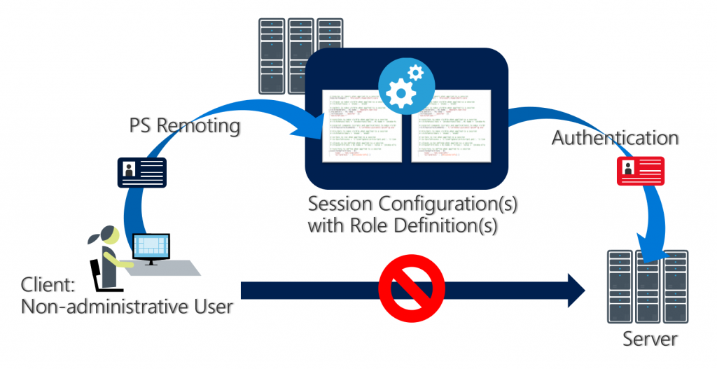
JEA - Overview
https://blogs.technet.microsoft.com/miriamxyra/2018/05/10/securing-your-infrastructure-with-just-enough-administration

Slide 23
JEA - Prerequisites
JEA requires at least the Windows Management Framework 5.0.
With the WMF 5.0 installed, you will have the ability to install the xJEA module using the Install-Module cmdlet.
PowerShell Remoting must be enabled

Slide 24
JEA – Key Concepts
PowerShell Remoting:
Allows you to run PowerShell commands against remote machines.
You can operate against one or many computers, and use either temporary or persistent connections.
“RunAs” User:
When using JEA, a non-administrator “runs as” a privileged “Virtual Account.”
The Virtual Account only lasts the duration of the remote session.
That is to say, it is created when a user connects to the endpoint, and destroyed when the user ends the session.
By default, the Virtual Account is a member of the local administrators group.
On a domain controller, it is also a member of Domain Administrators.
“Connected” User:
The non-administrator user who runs as the “RunAs” user through PowerShell remoting.

Slide 25
JEA – Key Concepts
PowerShell Modules are essentially packages of PowerShell functionality.
They can contain PowerShell functions, cmdlets, DSC Resources, Role Capabilities, and more.
In order to be automatically loaded, PowerShell Modules must be located on $env:PSModulePath.
Role Capability (.psrc):
A file that define “what” a user can do at a JEA endpoint.
It details a whitelist of things like visible commands, visible applications, and more.
In order for PowerShell to detect Role Capabilities automatically, you must put them in a “RoleCapabilities” folder in a valid PowerShell module.

Slide 26
JEA – Limits
Considerations When Limiting Commands
It is critical that all capabilities exposed through JEA are located in administrator-restricted areas.
Non-administrator users should not have the capability to modify the scripts used through JEA endpoints.
It is critical to not give JEA users the ability to overwrite these scripts through JEA Endpoints.
Signing PSSC (PS Session Configuration file aka ‘Who’) and PSRC (PS Role Capability File aka ‘What’) Files

Slide 27
Key concepts: Auditing

Slide 28
Security Audit Recommendations
Useful guides are:
Best Practices for Securing Active Directory
Audit Policy Recommandations
Threats and Countermeasures Guide: Advanced Security Audit Policy

Slide 29
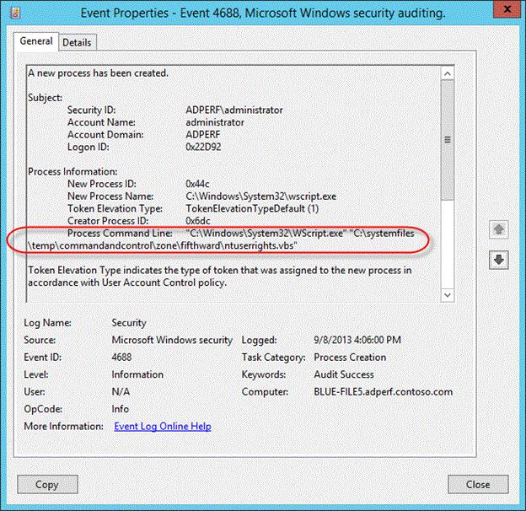
Auditing Process Creation – Overview since KB3004375
Audit Process Creation policy to include the command information that is passed to every process is available since Windows 7/Windows Server 2008 R2 OS versions
Events are logged in existing event ID 4688 and in the Windows Security log
Notes:
https://support.microsoft.com/kb/3004375

Slide 30
Auditing Process Creation
Enable this feature, administrators must follow these steps:
Enable the Audit Process Creation policy.
Enable the "Include command line in process creation events" feature.
For more information about how to configure these two features, see the Configuration section.

Slide 31
Key concepts: Device Guard

Slide 32
Device Guard Overview
Device Guard is the ability to lock down devices in a way that provides advanced malware protection against new and unknown malware variants as well as Advanced Persistent Threats (APT’s).
It provides better security against malware and zero days for Windows 10 by blocking anything other than trusted apps—which are apps that are signed by specific software vendors, the Windows Store, or even your own organization.
Deployment guide is available here: https://docs.microsoft.com/en-us/windows/device-security/device-guard/device-guard-deployment-guide

Slide 33
Device Guard Overview
You’re in control of what sources Device Guard considers trustworthy and it comes with tools that can make it easy to sign Universal or even Win32 apps that may not have been originally signed by the software vendor.
Device Guard restricts devices to only run authorized apps by using a feature called configurable code integrity (CI), while simultaneously hardening the OS against kernel memory attacks through the use of virtualization-based protection of code integrity (more specifically, HVCI).
Note: Device Guard devices that run Kernel Mode Code Integrity with virtualization-based security must have compatible drivers. For additional information, please read the Driver compatibility with Device Guard in Windows 10 blog post.

Slide 34
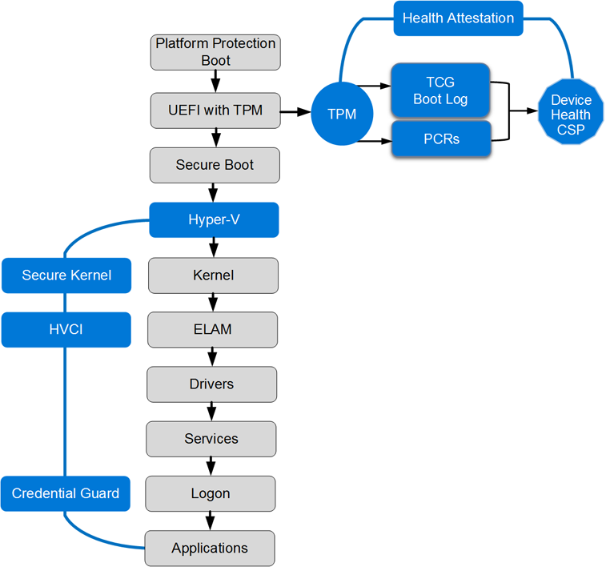
Windows 10 hardware-based security defenses
Virtualization-based security (Hyper-V + Secure Kernel). Virtualization-based security is a completely new enforced security boundary that allows you to protect critical parts of Windows 10.
Hypervisor-protected Code Integrity (HVCI). Hypervisor-protected Code Integrity is a feature of Device Guard that ensures only drivers, executables, and DLLs that comply with the Device Guard Code Integrity policy are allowed to run.
Notes:
https://docs.microsoft.com/en-us/windows/security/threat-protection/protect-high-value-assets-by-controlling-the-health-of-windows-10-based-devices

Slide 35
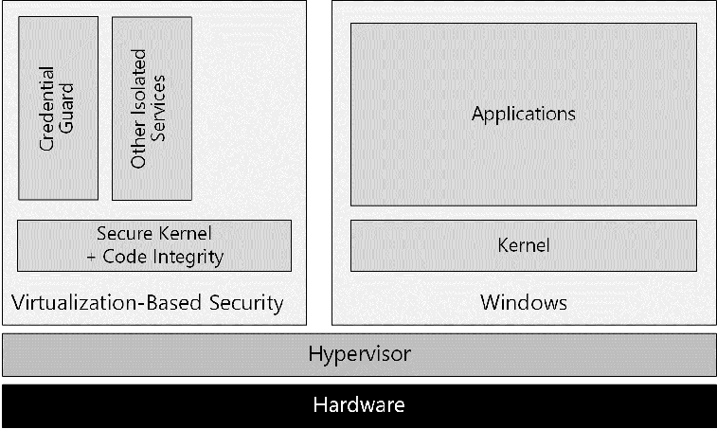
Windows 10 with virtualization-based security
The trust decision to execute code is performed by using Hyper-V Code Integrity, which runs in virtualization-based security, a Hyper-V protected container that runs alongside regular Windows.
Hyper-V Code Integrity is a feature that validates the integrity of a driver or system file each time it is loaded into memory. Code integrity detects whether an unsigned driver or system file is being loaded into the kernel, or whether a system file has been modified by malicious software that is being run by a user account with Administrator privileges.
Notes:
https://docs.microsoft.com/en-us/windows/security/threat-protection/protect-high-value-assets-by-controlling-the-health-of-windows-10-based-devices

Slide 36
Device Guard: Hardware requirements
Hardware | Motivation
UEFI 2.3.1 or later firmware with Secure Boot enabled | Required to support UEFI Secure Boot. UEFI Secure Boot ensures that the device boots only authorized code. Additionally, Boot Integrity (Platform Secure Boot) must be supported following the requirements in Hardware Compatibility Specification for Systems for Windows 10 under the subsection: “System.Fundamentals.Firmware.CS.UEFISecureBoot.ConnectedStandby”
Virtualization extensions, such as Intel VT-x, AMD-V, and SLAT must be enabled | Required to support virtualization-based security. Note Device Guard can be enabled without using virtualization-based security.
X64 processor | Required to support virtualization-based security that uses Windows Hypervisor. Hyper-V is supported only on x64 processor (and not on x86). Direct Memory Access (DMA) protection can be enabled to provide additional memory protection but requires processors to include DMA protection technologies.
IOMMU, such as Intel VT-d, AMD-Vi | Support for the IOMMU in Windows 10 enhances system resiliency against DMA attacks.
Trusted Platform Module (TPM) | Required to support health attestation and necessary for additional key protections for virtualization-based security. TPM 2.0 is supported; TPM 1.2 is also supported beginning with Windows 10, version 1703.

Slide 37
Key concepts: Credential Guard

Slide 38
Credential Guard
Credential Guard uses virtualization-based security to isolate secrets, such as NTLM password hashes and Kerberos Ticket Granting Tickets, so that only privileged system software can access them.
Credential Guard is included in Windows 10 Enterprise and Windows Server 2016.

Slide 39
Credential Guard
More information available in Module 1 of the Active Directory Security course

Slide 40
Key concepts: Desired State Configuration

Slide 41
What is Desired State Configuration (DSC)?
New management platform in Windows PowerShell
Enable deployment and management of a remote machine’s software and host OS
PowerShell language extensions, cmdlets, and resources to declaratively specify state
Enforce the desired state and prevent configuration drift
No procedural scripting required

Slide 42
DSC - Prerequisites
Method of specifying the configuration to be present on a computer
PowerShell language extension in v4.0
Enables deployment and management of software configuration
Allows continuous configuration testing and re-application to prevent configuration drift
Resources specify how software is to be configured
Requires PowerShell Remoting to be enabled
Not supported on 32-bit operating systems

Slide 43
DSC - Imperative vs. Declarative Language
Imperative
Declarative
Add-WindowsFeature Windows-Server-Backup
Configuration BaseBuild {
WindowsFeature Backup {
Ensure = "Present"
Name = "Windows-Server-Backup"
}
}

Slide 44
DSC - Scope
Automate configuration of a set of computers (target nodes)
Option to create custom resources to configure the state of any application or system setting
Scripts
Environment Variables
Registry
Repair
Desired
State
Report
Desired
State
Deploy
Software
Roles and
Features
Files and
Directories
Processes and Services
Users and
Groups

Slide 45
DSC – DCS versus Group Policies
DSC
No domain needed
Works with no network at all
MOF based (open platform)
Not as simple to deploy
Authentication flexibility
Requires PS v4.0
GPO
Only works in domain scenario
Connectivity generally needed
Born from registry control
Fairly easy to setup and deploy
Well-known and established
Requires remoting is enabled
Works everywhere
Resources drive scalability
New unknown factor

Slide 46
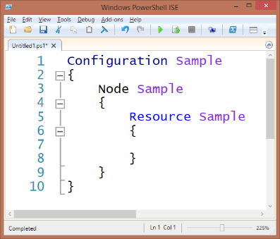
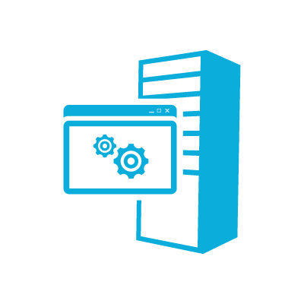

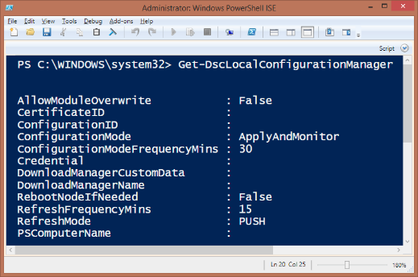

DSC – Components
DSC
Configuration
MOF Files
Local Configuration Manager
Optional Pull Server
Resources

Slide 47



DSC – Distribution Modes (Psh vs. Pull)
Authoring
Staging
Nodes
Config Pushed
Config Pulled
Server1
Configs Deployed
Server1.mof
Config Pulled
Server1.mof
IIS
Server1
Server1.mof
Configs Deployed
Server1.mof
File Share
Server1

Slide 48
DSC - Configuration Script
Defines the desired configuration and separates the configuration logic ("What") from the node data ("Where")
Simplifies configuration data reuse
Definitions consist of nested hash tables
Configuration block (outer wrapper for a complete state)
Node blocks (inner wrapper for node(s))
Resource blocks
Configuration data

Slide 49
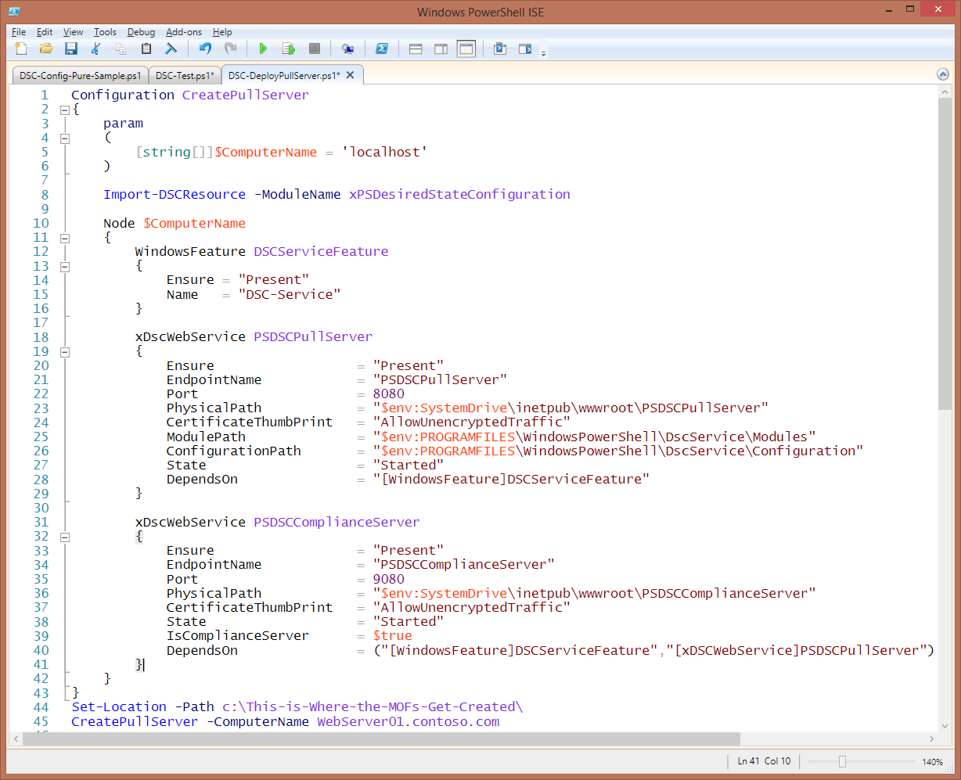
DSC - Configuration Script
Declarative end state
Simpler than a script
More like an old .ini

Slide 50
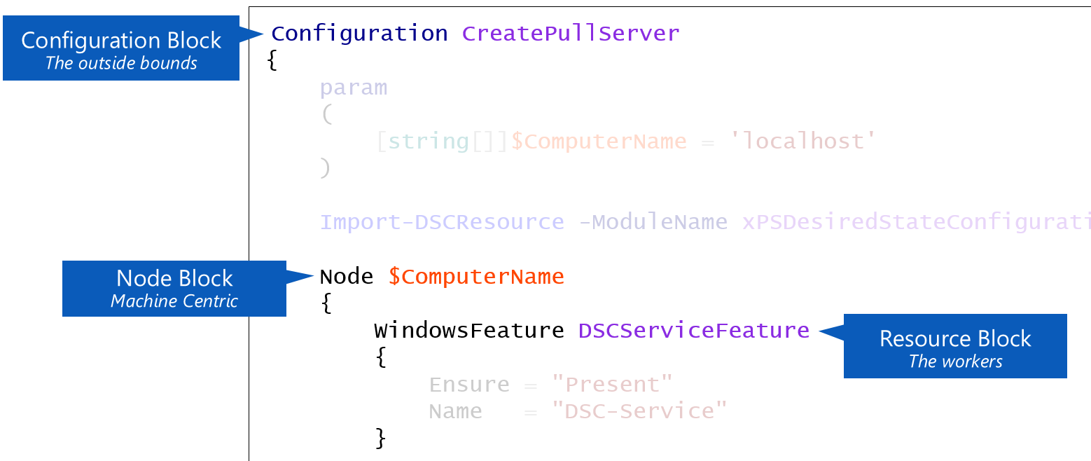
DSC - Configuration Script Blocks

Slide 51
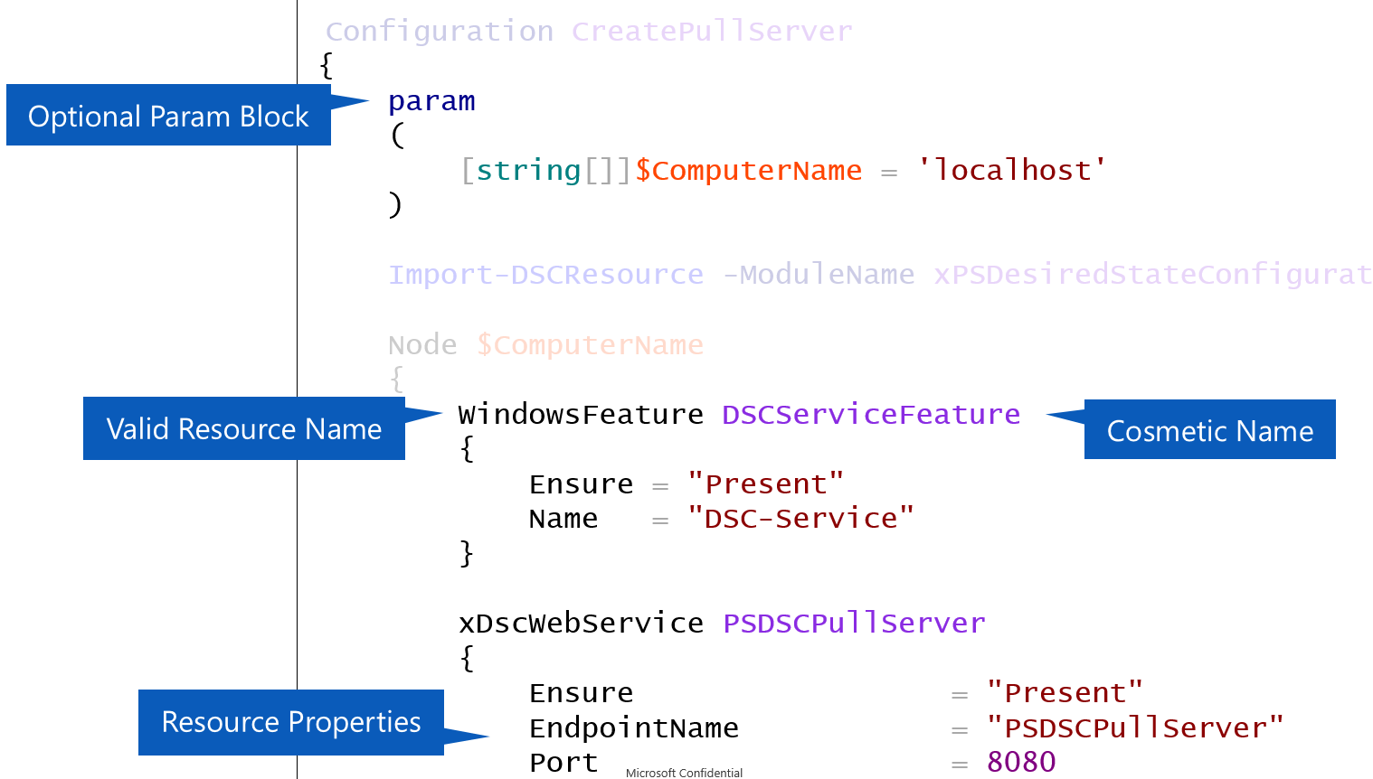
DSC - Configuration Script Blocks

Slide 52
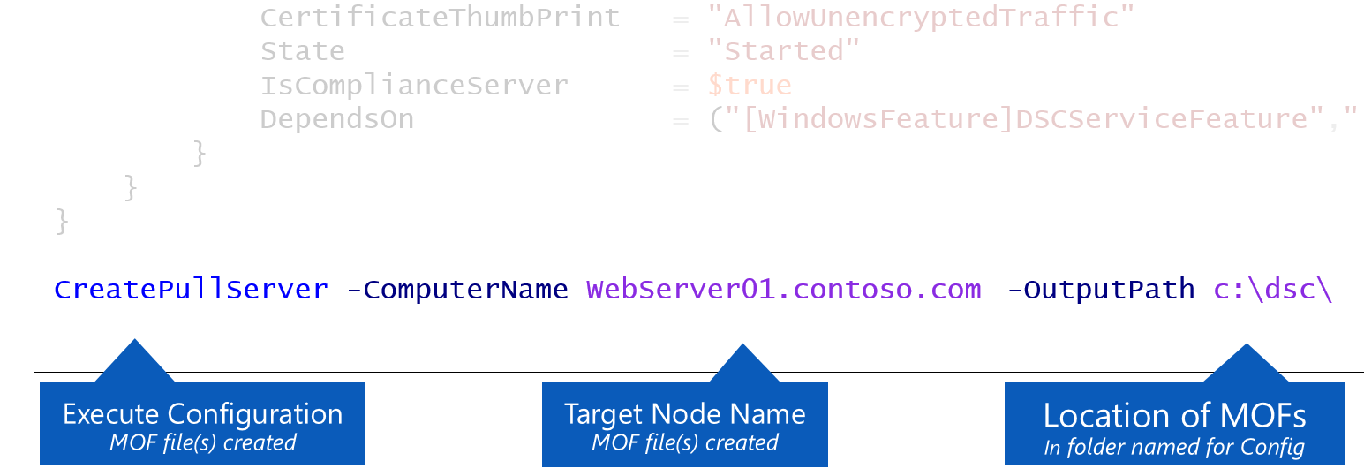
DSC - Configuration Script Blocks

Slide 53
Built-in DSC Resources
 | Column
Unpacks archive (.zip) files at specific paths | Archive
Manages system environment variables | Environment
Manages files and directories | File
Manages local groups | Group
Logs configuration messages | Log
Installs and manages Windows Installer and setup.exe packages | Package
Configures Windows processes | Process
Manages registry keys and values | Registry
Adds or removes Windows features and roles | Role
Runs PowerShell script blocks | Script
Manages services | Service
Manages local user accounts | User

Slide 54
DSC – Create Custom Resources
Use xDSCResourceDesigner Module (much easier)
Create an empty parent module
Create resource sub-modules (1 per resource)
Standard functions required for each
Get-TargetResource
Set-TargetResource
Test-TargetResource

Slide 55
DSC – *-TargetResource Functions
Functions contain PowerShell code necessary to implement the state
Code will differ based on target technology
Specific output requirements of each function
Get-TargetResource function returns the current state.
Set-TargetResource function sets the system state.
Test-TargetResource function compares the current state to the desired state.

Slide 56
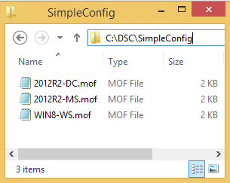
DSC – Sequences
1. Author Configuration
Configuration SimpleConfig
{
$Nodes = '2012R2-MS','2012R2-DC','WIN8-WS'
Node $Nodes
{
File CreateFolder
{
DestinationPath = 'c:\temp\'
Ensure = 'Present'
Type = 'Directory'
}
}
}
3. MOF Files Automatically Created
Directory: C:\dsc\SimpleConfig
Mode Length Name
----- ------ ----
-a--- 1266 2012R2-MS.mof
-a--- 1266 2012R2-DC.mof
-a--- 1262 WIN8-WS.mof
2. Execute Configuration
SimpleConfig -OutputPath c:\dsc\SimpleConfig

Slide 57
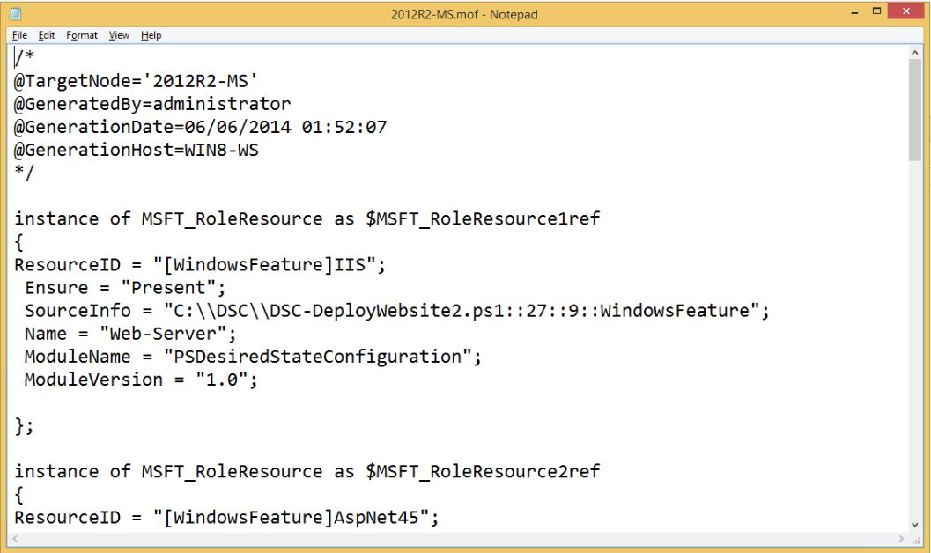
DSC – MOF (Managed Object Format)
DSC Middle-Man
Per Node In Pull Mode, node names are abstracted with a GUID
Cross Platform

Slide 58
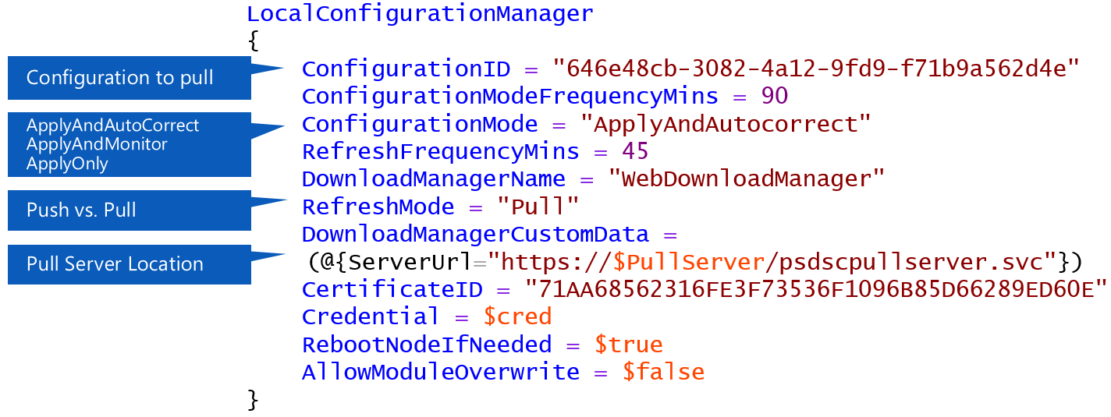
DSC – Local Configuration Manager (LCM)
LCM is configured through a DSC configuration (normally pushed once)

Slide 59
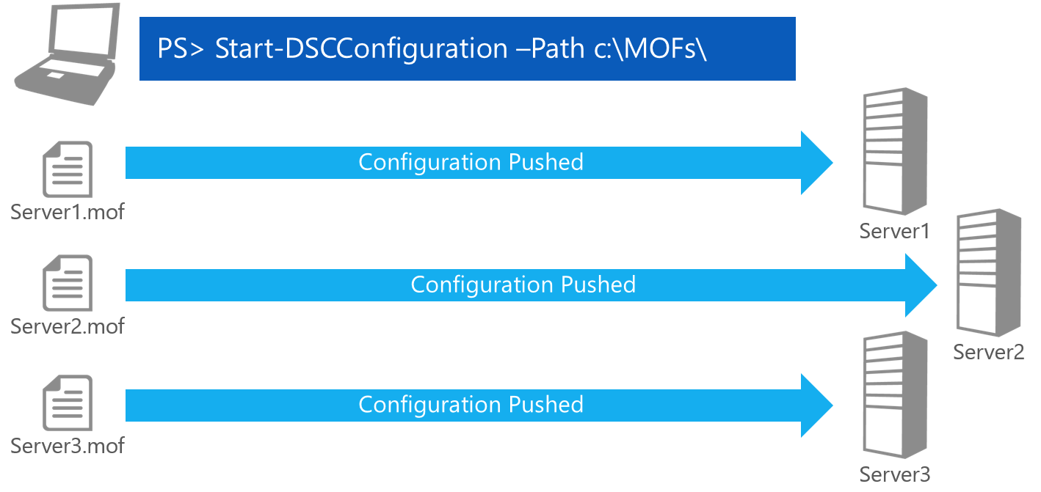
DSC – Pushing MOF(s)

Slide 60
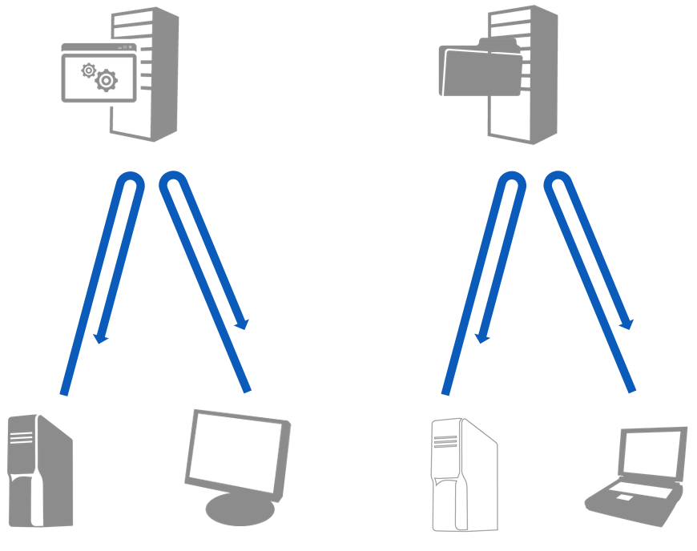
DSC – Pull Servers
Possible Server Modes
HTTPS Web Server
HTTP Web Server
SMB File Share
Local configuration manager
on target node pulls the
configuration

Slide 61
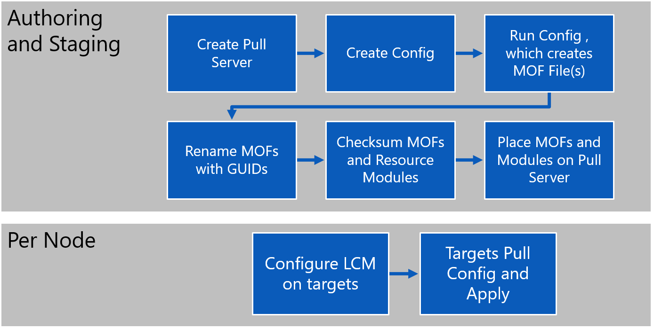
DSC – Setting up for Pull

Slide 62
DSC – Local Configuration Manager (LCM) - File Structure Overview
$env: psmodulepath (folder)
|- <ModuleName> (folder)
|- <ModuleName>.psd1 (file)
|- DSCResources (folder)
|- <ResourceName1> (folder)
|- <ResourceName1>.psm1 (file, required)
|- <ResourceName1>.schema.mof (file, required)
|- <ResourceName2>(folder)
|- <ResourceName2>.psm1 (file, required)
|- <ResourceName2>.schema.mof (file, required)

Slide 63
Key concepts: Network components

Slide 64
Network components
Windows Firewall and audit drops
Legacy protocol disabling (like SMBv1 or WebDAV)

Slide 65
Network components – Disable SMBv1 – PROs and CONs
PROs:
Latest ransomware issue where related to SMBv1 weakness exploit.
On the recent Windows 10 version 1709, SMBv1 is not installed by default.
https://support.microsoft.com/en-us/help/4034314/smbv1-is-not-installed-windows-10-and-windows-server-version-1709
CONs:
Keep in mind Named Pipes can be over SMB.
Compatibility issue with Legacy OS (XP/2003/2000).
Compatibility issue with Legacy SAMBA distribution (not SMBv2/SMBv3).
https://blogs.technet.microsoft.com/filecab/2017/06/01/smb1-product-clearinghouse/
https://www.rootusers.com/disable-smb-version-1-0-windows-10/
Notes:
More information:
https://www.offensive-security.com/metasploit-unleashed/scanner-smb-auxiliary-modules/

Slide 66
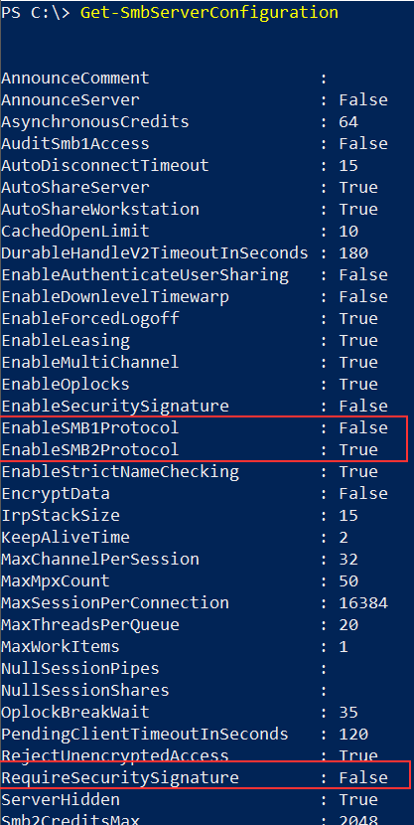
Network components – Disable SMBv1 – How to check?
Using Powershell command: “Get-SmbServerConfiguration”

Slide 67
Key concepts: PowerShell hardening

Slide 68
PowerShell - Overview
PowerShell is powerful scripting language.
Running in elevated context it allows to execute code

Slide 69
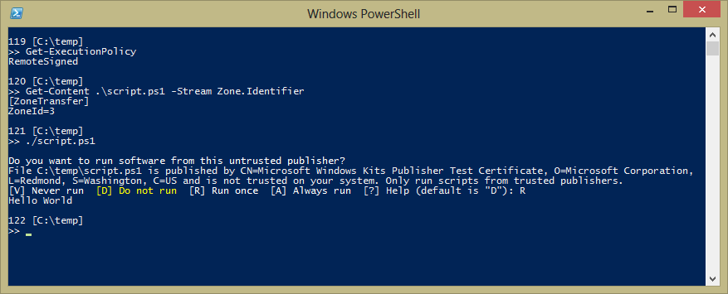
Operational Security – Execution Policy
Policies:
Never (“Restricted”)
Only if signed (“AllSigned”)
Only if signed (if the script was downloaded from the internet) (“RemoteSigned”)
Always, but prompt if the script was downloaded from the internet (“Unrestricted”)
Always (“Bypass”)
Notes:
PowerShell has a similar and additionally refined mechanism called the ‘Execution Policy’. Rather than having an ‘executable’ bit attached to files, PowerShell offers a user preference when running scripts:
Never (“Restricted”)
Only if signed (“AllSigned”)
Only if signed (if the script was downloaded from the internet) (“RemoteSigned”)
Always, but prompt if the script was downloaded from the internet (“Unrestricted”)
Always (“Bypass”)
PowerShell’s understanding of “Remote” comes from the Zone.Identifier alternate data stream that IE, Outlook, Lync, Firefox, and other applications attach to files when they download them.
Users can control this preference through the Set-ExecutionPolicy cmdlet, which can set the execution policy at three different scopes: Machine, User, and Process. PowerShell also offers a command-line parameter (“PowerShell –ExecutionPolicy <…>”) to control this at launch.
In PowerShell V1, we made the mistake of only offering this at the machine scope. That gave some people the mistaken impression that this was a user restriction, which it absolutely is not. After all, nothing prevented a user from typing in the commands manually. We rectified this in PowerShell V2 (2008), but the misunderstanding unfortunately sometimes persists.
Some researchers have talked about “Bypassing PowerShell’s execution policy” as a form of attack. If an attacker is changing your execution policy – they already have arbitrary code running and you have your hands full.

Slide 70
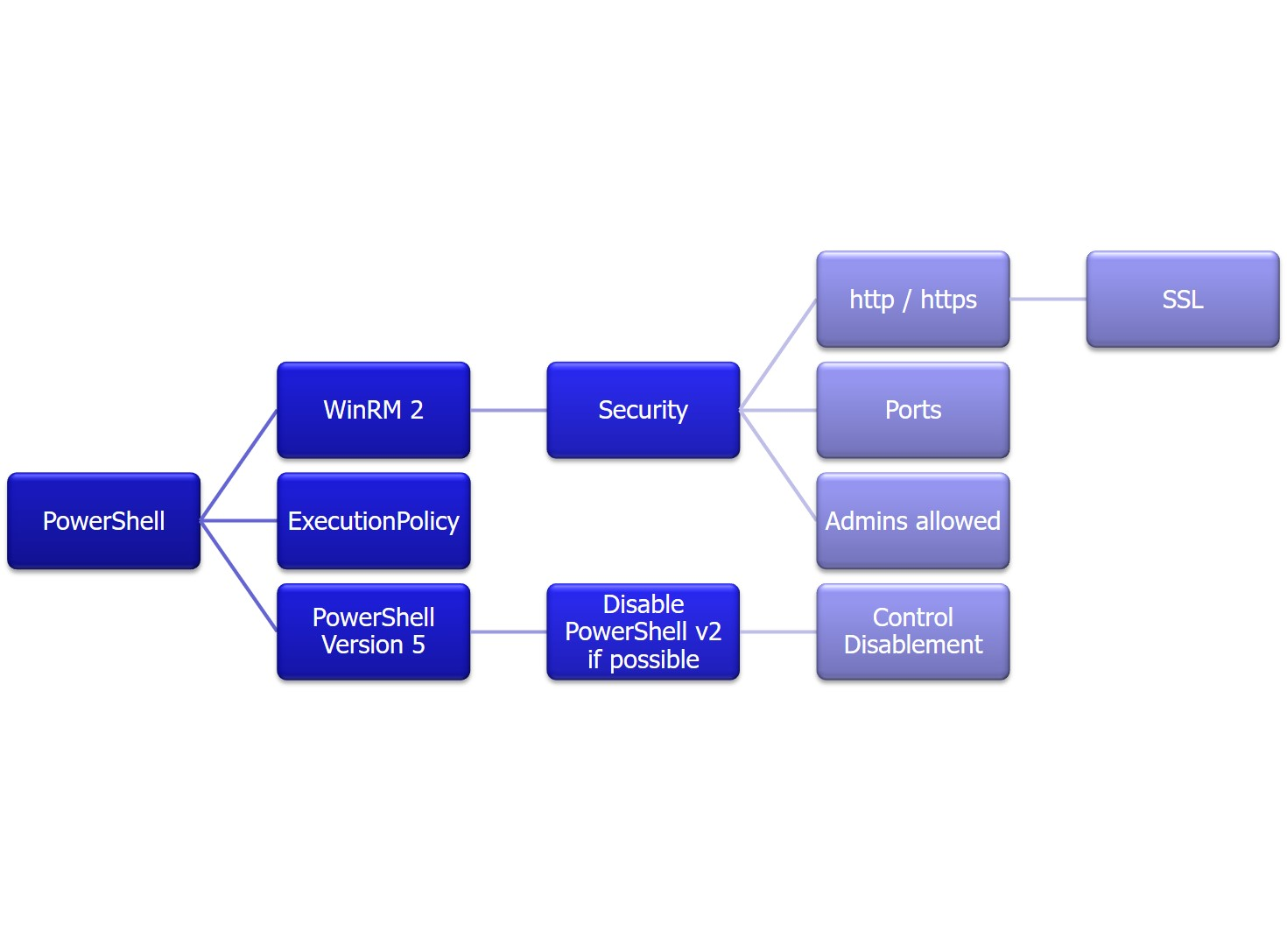
Operational Security – PowerShell Remoting
Understanding the Double-Hop problem
Authentication: Kerberos vs. CredSSP – Pass the Hash?
Accessing Remote Resources
For highly-trusted servers, you can:
Enable Kerberos Constrained Delegation
Use the ‘-Authentication CredSSP’ parameter when connecting to the remote machine.
For regular servers, you can:
Update the permissions on the remote resource to grant access to the machine account.
Provide explicit credentials to remote resources. For example, New-PSDrive \\FileServer\Share –Credential (…), or net use \\FileServer\Share
Notes:
In Windows, we’ve been become accustomed to the single sign-on experience provided by Active Directory. When you access a server (i.e.: an intranet website), it just knows who you are and can provide a customized experience. Windows’ default authentication protocols ensure that the target server can’t steal your credentials and access other computers on your behalf. PowerShell Remoting uses Windows’ Kerberos protocol by default, which carries the same guarantee.
However, if you WANT to access other servers on your behalf (i.e.: files on a file server) from within a PowerShell Remoting session, you’ll run into errors. This is known as the Double-Hop problem. This is a much better problem to have than the alternative: credential theft and pass-the-hash style attacks.
For highly-trusted servers, you can:
Enable Kerberos Constrained Delegation (vastly improved in Windows Server 2012). This will allow the server to act on the user’s behalf.
Use the ‘–Authentication CredSSP’ parameter when connecting to the remote machine. This opens you up to credential theft, so is disabled by default on both the client and the server.
For regular servers, you can:
Update the permissions on the remote resource (i.e.: file server) to grant access to the machine account of the remoting host rather than the users.
Provide explicit credentials to remote resources. For example, New-PSDrive \\FileServer\Share –Credential (…), or net use \\FileServer\Share

Slide 71
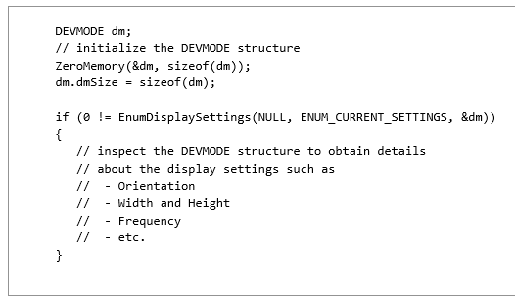
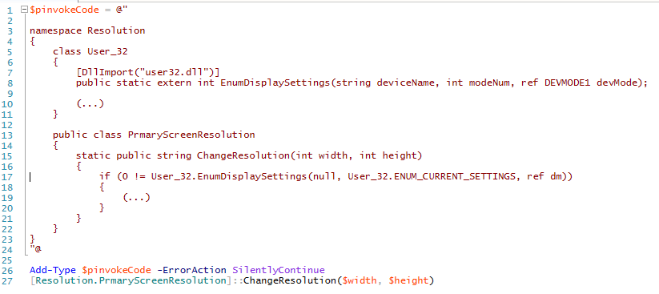
Operational Security – Scripts <-> Executables
Moving to Post-Exploitation defense
Rely either on AppLocker and Audit
Notes:
When it comes to operational security, one primary avenue of thought is limiting post-exploitation behaviours. The attacker exploited your web application, SQL database, or user, and is already running arbitrary code on your system. Next, you want to limit what they can accomplish.
The most common mistake that administrators make about PowerShell (or any scripting language, for that matter) to think about it differently than they think about traditional applications. You would never hear an administrator say, “I want to secure my system against C++ attacks”, but you frequently hear them ask how to secure their system against PowerShell attacks. Any useful programming or scripting language (PowerShell being one of them) is capable of doing anything that a C++ program can. PowerShell runs in the user’s context, so can’t do anything that the user (or an application that they’re running) couldn’t already do.
There are, of course, people who think deeply about application restrictions and apply stringent lockdowns to their system. To do this, you can apply AppLocker policies to whitelist specific applications and disallow all others. A system without a whitelist implementation has very little defense after being compromised. The attackers can use their own tools, or simply compile them on the machine with the OS’ included compilers. Antivirus is useful, but will never catch targeted or custom-written tooling.
Once you’ve got a secure AppLocker policy deployed, the next step is to address in-box scripting mechanisms: HTAs (“HTML Applications”), local web pages (which run at much higher trust levels than internet web pages and can do much more), Jscript scripts, VBScript scripts, Office macros, and PowerShell scripts. You might address these avenues by a whitelisting AppLocker script policy, along with an extremely aggressive audit policy and custom tooling for HTAs, local web pages, and Office macros.

Slide 72
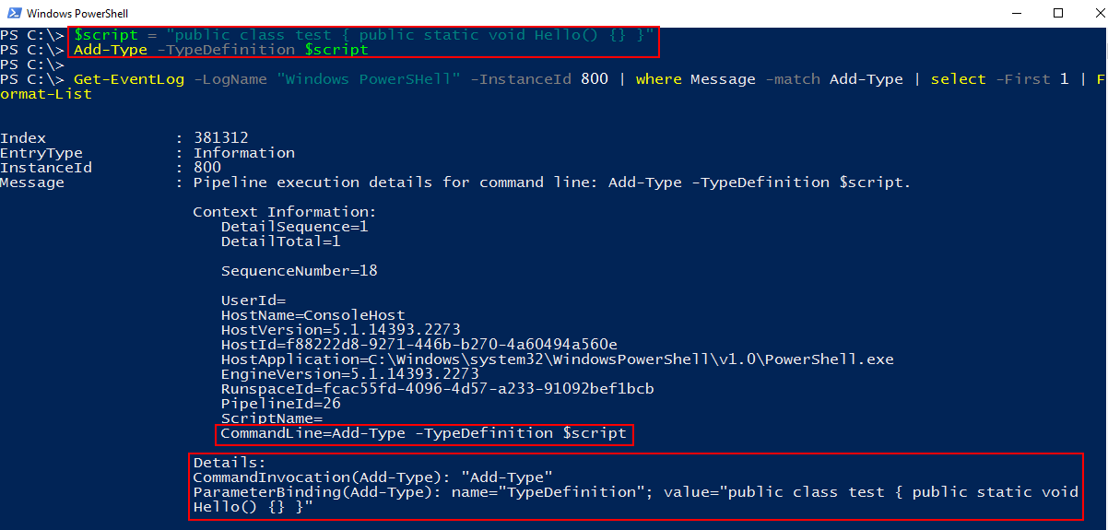
Operational Security – Dealing with Forensics
Preventing unrestricted admin access
System-wide Transcripts
Automatic Module logging
Detecting attacks on mitigations
Notes:
The first way to deal with post-exploitation operational security is to limit what an exploited user is capable of. PowerShell can only do what the user can do. If you have fully-privileged administrators running around everywhere, an compromised administrator account can quickly turn into a security nightmare.
Fortunately, PowerShell offers a way to address this through the concept of Constrained / Delegated Administration. Rather than expose fully-featured PowerShell remoting endpoints to your administrators, you can instead create task-specific “tool boxes” for them to connect to. In this constrained endpoint, you limit the PowerShell remoting session to only expose the commands or scripts for tasks that your administrators need to run. You can even configure the restricted session to run under an alternate credential (such as a service account) to ensure that the administrator’s ability to connect to PowerShell remoting doesn’t grant them access to the machine in any other way.
If creating constrained endpoints for management tasks is not an option, PowerShell offers two techniques for ubiquitous logging:
System-wide transcripts. When PowerShell starts up, it goes through a chain of initialization scripts known as “profile scripts”. The system-wide profile script (run for every session and every user) is located at $pshome\profile.ps1. You can place a call to ‘Start-Transcript’ in this profile to log all interactive use of PowerShell.
Automatic Module logging. In addition to system-wide transcripts, PowerShell supports both registry settings and Group Policies to log ‘pipeline execution details’ - the parameters used for all PowerShell cmdlets in a pipeline. This is described in the Module Logging section of about_Group_Policy_Settings.
Once these are set up, be sure to protect yourself attacks on these mitigations. An administrator of the system could disable these settings – so you’ll want to audit any changes to profile.ps1 or the registry keys that control module logging.

Slide 73
PowerShell Scripting Security
1
2
3
Script Encryption / Obfuscation
Avoiding Code Injection
Avoiding Hard-Coded Secrets

Slide 74
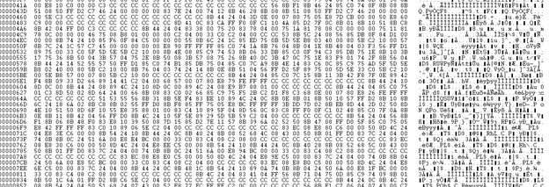
PowerShell Scripting Security - Script Encryption / Obfuscation
Script content can be obfuscated and encrypted using tools, but not recommended and trustful.
Notes:
One common questions we get is how to encrypt / obfuscate PowerShell scripts. There are even tools that do it and seem capable!

Slide 75
PowerShell - Overview
Common approach is to obfuscate a script through textual transformations:
for example, decrypt a string, and then run the resulting string through Invoke-Expression.
In this case, an attacker can simply change the script to output what was just about to be supplied to Invoke-Expression.
If it’s done through an application hosting the PowerShell runtime, the attacker can simply use traditional native debugging techniques to see the content when it gets decrypted.

Slide 76
PowerShell - Overview
One notable exception to this “Script Encryption is Useless” stance is when a script takes a dependency on something external to the script as a decryption key for the content.
For example, a script can prompt the user for a password before using that to decrypt the string supplied to Invoke-Expression.
That is actual security as long as the password isn’t anywhere that an attacker can get access to it.
Another common form of script obfuscation is through techniques like variable renaming and flow obfuscation.
Like other languages, you can of course rewrite a PowerShell script (either manually or through a tool) in a way that makes it exceedingly difficult to understand.
No automated tool currently exists to do this with PowerShell scripts, and this class of tool rarely provides much more than a speed bump.

Slide 77
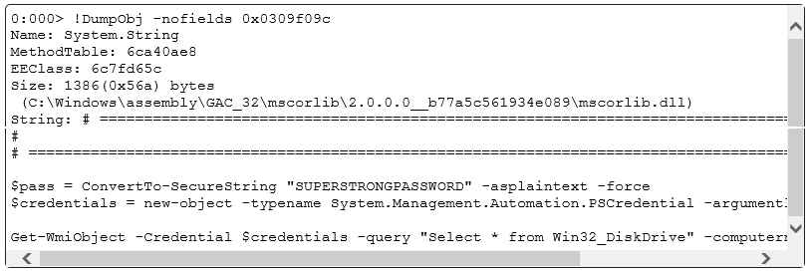
PowerShell Scripting Security - Script Encryption / Obfuscation
Script content can be obfuscated and encrypted using tools, but not recommended.
Notes:
Ultimately, they aren’t.
The most common approach is to obfuscate a script through textual transformations – for example, decrypt a string, and then run the resulting string through Invoke-Expression. In this case, an attacker can simply change the script to output what was just about to be supplied to Invoke-Expression. If it’s done through an application hosting the PowerShell runtime, the attacker can simply use traditional native debugging techniques to see the content when it gets decrypted.
One notable exception to this “Script Encryption is Useless” stance is when a script takes a dependency on something external to the script as a decryption key for the content. For example, a script can prompt the user for a password before using that to decrypt the string supplied to Invoke-Expression. That is actual security as long as the password isn’t anywhere that an attacker can get access to it.
Another common form of script obfuscation is through techniques like variable renaming and flow obfuscation. Like other languages, you can of course rewrite a PowerShell script (either manually or through a tool) in a way that makes it exceedingly difficult to understand. No automated tool currently exists to do this with PowerShell scripts, and this class of tool rarely provides much more than a speed bump.

Slide 78

PowerShell Scripting Security – Avoiding Code Injection
When dealing with dynamic commands or parameters, it’s common to fall back to old programming practices: system(), eval(), exec()
Maybe Invoke-Expression?
Notes:
People coding in PowerShell often bring their expectations from their past languages. Nearly every compiled or scripting language offers a way to “shell out” and run commands. In shell-oriented languages like PowerShell (and CMD, and Bash, …), command invocation is the primary motivation.
While people understand that they don’t need to write “Invoke-Expression” before every command invocation, they start to flail around when trying to invoke commands with parameter values that aren’t hard-coded.

Slide 79
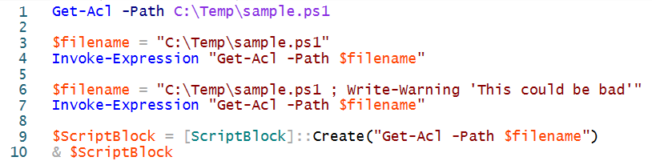
PowerShell Scripting Security - Avoiding Code Injection
The Invoke-Expression (and [ScriptBlock]::Create()) constructs tell PowerShell to invoke whatever you’ve supplied as executable code. Almost every programming or scripting language offers a construct like this (SQL, Javascript, C, C++, Java, etc.), and PowerShell is no different.
However, PowerShell offers several constructs that make these techniques almost never necessary.

Slide 80
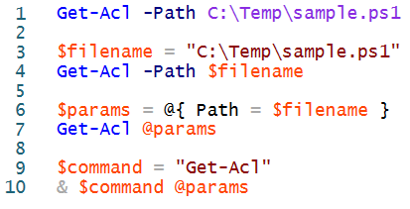
PowerShell Scripting Security - Avoiding Code Injection
To supply a variable’s value to a parameter, just use the variable as the parameter value rather than a hard-coded string.
Get-Acl -Path $filename
If you don’t know the parameter name beforehand, you can pack your arguments into a hash table and use ‘splatting’. Splatting lets you supply a hash table as the parameter names and values of a command invocation.
Get-Acl @params
If you don’t know the command name beforehand, you can use PowerShell’s invocation (&) operator.
$command = "Get-Acl"
& $command @params

Slide 81
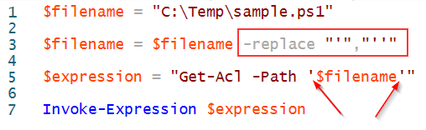
PowerShell Scripting Security - Avoiding Code Injection
Sometimes, you TRULY need Invoke-Expression. This is incredibly rare. It is more likely that you just need to look harder for other options.
When you actually need Invoke-Expression:
you can neutralize user input by placing it in a single-quoted string, and escape any single quotes in the user’s string with double quotes.
This is easy to get wrong (especially if you are joining multiple strings, or going through multiple layers), so you should avoid this when you can.

Slide 82
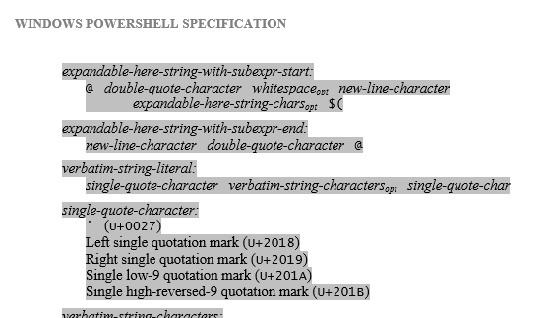
PowerShell Scripting Security - Avoiding Code Injection
The most common way that administrators script is through copy, paste, and modification. And the most common sources of these scripts are… Outlook. Word. Blogs. News groups. Most of these sources turn quotes into “smart quotes”, completely destroying any programming language that is ignorant of them.
To address this, PowerShell treats a class of Unicode quote characters as single quotes. Any escaping technique you implement should be sure to account for these.

Slide 83
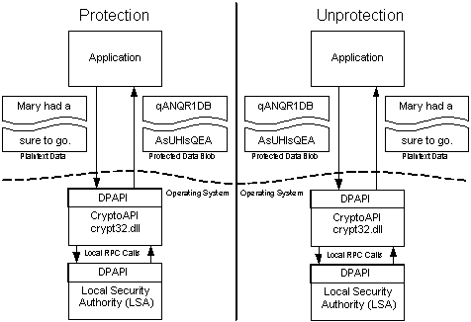
PowerShell Scripting Security - Avoiding Code Injection
Hard-coded secrets in scripts are a huge source of information disclosure in an operational environment. Domain credentials. SQL passwords and connection strings. System / user identities. Any of these can provide an attacker with useful data when extracted from a open share, file system, or repository.
To address this difficulty, Windows offers the Data Protection API (DPAPI). The DPAPI lets you encrypt secrets in a way that can only be decrypted by the same user on the same machine.
Data protection through Windows’ Data Protection API (DPAPI)

Slide 84
PowerShell Scripting Security - Avoiding Hard-Coded Secrets
The first way to avoid secrets laying around is to use C# SecureStrings to hold your sensitive data.
PowerShell stores all of your secrets as SecureStrings, and offers the “-AsSecureString” parameter to the Read-Host cmdlet as a way to enter them.
Parameters can be marked to take secure strings, and PowerShell will securely prompt for them automatically if the user does not supply them.
The Export-CliXml cmdlet exposes PowerShell’s rich serialization functionality.
When given a SecureString (either directly, or when nested in an object), it uses the DPAPI to encrypt the string into a data blob that only you can decrypt.
When you use the Import-CliXML cmdlet, PowerShell decrypts the data blob (again using the DPAPI) and puts it back in a SecureString.

Slide 85
PowerShell Scripting Security - Avoiding Hard-Coded Secrets
Since credentials are the most common source and requirement for script secrets, PowerShell supports the secure prompting, export, and import of credentials directly.
If you need to encrypt a secret and share it with another user (or use it on another machine), you can use the -SecureKey parameter for the SecureString cmdlets.
Be careful, though – this key is a secret too.
If you find the key in a script, you can use that key to decrypt whatever sensitive data it was protecting.
Some options to protect the key are environment variables (as long as the attacker doesn’t have access to the process), web services (as long as the attacker doesn’t have access to the web service too), etc.

Slide 86
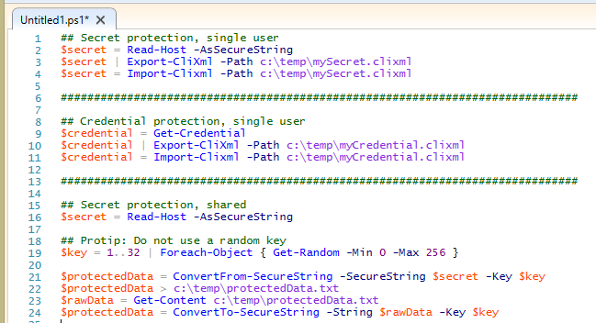
PowerShell Scripting Security - Avoiding Hard-Coded Secrets
Export / Import CliXml
ConvertFrom / ConvertTo SecureString

Slide 87
PowerShell Resources
Reflective DLL Loading with PowerShell: http://www.youtube.com/watch?v=OAd68_SYQc8
Living off the Land: http://www.youtube.com/watch?v=j-r6UonEkUw
Get-Help about_Group_Policy_Settings http://technet.microsoft.com/en-us/library/jj149004.aspx
Constrained PowerShell Endpoints http://www.youtube.com/watch?v=kmjJLKlL1Wg
PowerShell Language Specification: http://www.microsoft.com/en-us/download/details.aspx?id=36389
Composing Command Arguments: http://www.powershellcookbook.com/recipe/XoMw/run-programs-scripts-and-existing-tools
Windows PowerShell Securing the Shell
https://technet.microsoft.com/en-us/library/2007.09.powershell.aspx

